Slide 1



Instructions for use
SMARTCOP
EDIT IN GOOGLE SLIDES
Click on the button under the presentation preview that says "Use as Google Slides Theme".
You will get a copy of this document on your Google Drive and will be able to edit, add or delete slides.
You have to be signed in to your Google account.
EDIT IN POWERPOINT®
Click on the button under the presentation preview that says "Download as PowerPoint template". You will get a .pptx ﬁle that you can edit in PowerPoint.
Remember to download and install the fonts used in this presentation (you’ll ﬁnd the links to the font ﬁles needed in the Presentation design slide)
AUTOMATED PLATFORM TO MITIGATE THE IMPACT OF ROAD ACCIDENTS
More info on how to use this template at slidescarnival.com/help-use-presentation-template
This template is free to use under Creative Commons Attribution license. You can keep the Credits slide or mention SlidesCarnival and other resources used in a slide footer.
SLIIT
FACULTY OF COMPUTING 2020-052
9/23/2020
1

Slide 2


Group
Details
Supervisor Title | Supervisor Name
Supervisor | Dr. Windhya Rankothge
Co - Supervisor | Ms. Narmada Gamage
Member Name | ID
Sewwandi A.K.T | IT16165830
Dissanayake D.M.K.P. | IT16138896
Navanjani D.H.K.H | IT16170094
Shangavie R | IT16167124
SLIIT
FACULTY OF COMPUTING
2

Slide 3
^{Introduction}
Road traffic accident deaths in Sri Lanka reached 3,554 in 2017 or 2.80% of the total deaths [1]
Insufficient exposure and consciousness among populations about traffic environments and rules cause the growth of road accident statistics [2].
Exceeding speed limits, driving under the impact of alcohol and other psychoactive substances, non-use of motorcycle helmets, seat-belts, and child restraints and distracted driving are the primary risk factors for road traffic injuries [3].
We have proposed the SmartCop automated platform containing four modules;
road accident prediction
recommend and schedule police officers
a game-based learning approach to enhance road accident prevention awareness
a game-based learning approach to improve post road accident response awareness
SLIIT
FACULTY OF COMPUTING
9/23/2020
3

Slide 4


^{Research Problem}
How road accident prediction exactly reduce the impact of road accidents?
How to schedule traffic police officers accurately to reduce the impact of traffic accidents?
Do critical thinking skills gained through game-based learning more beneficial to learn road safety best practices?
How road accident response awareness will be improved through game-based learning?
SLIIT
FACULTY OF COMPUTING
9/23/2020
4

Slide 5
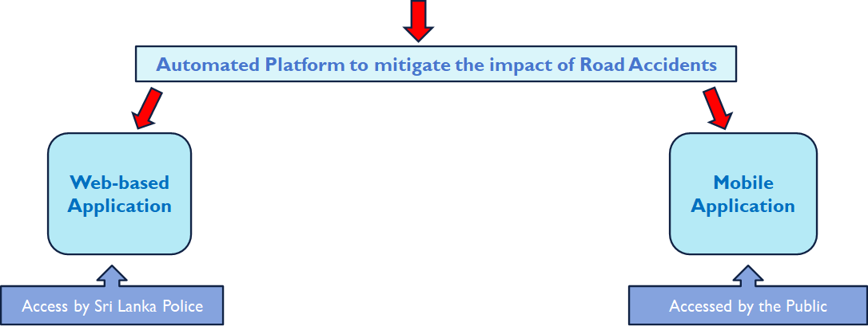
^{Solution}
SLIIT
FACULTY OF COMPUTING
9/23/2020
5

Slide 6
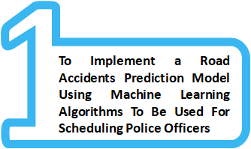
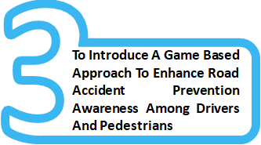

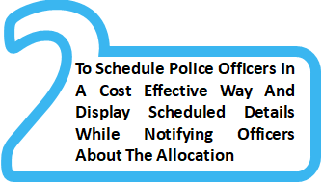
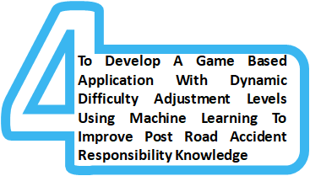
Research Objectives
SLIIT
FACULTY OF COMPUTING
9/23/2020
6

Slide 7
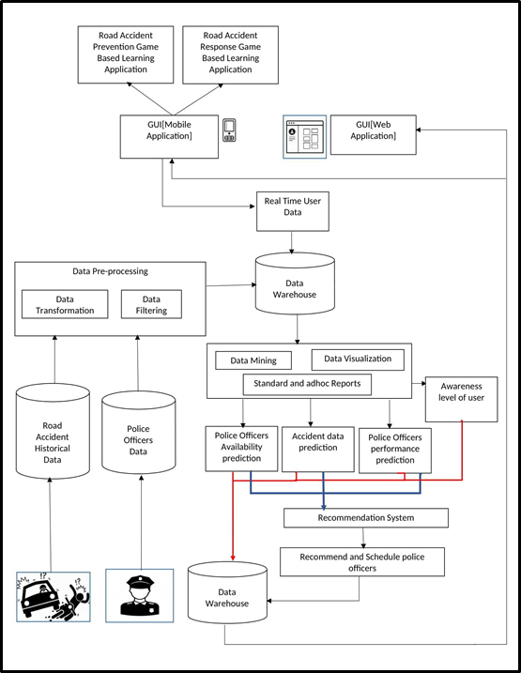
^{System Diagram}
SLIIT
FACULTY OF COMPUTING
9/23/2020
7

Slide 8


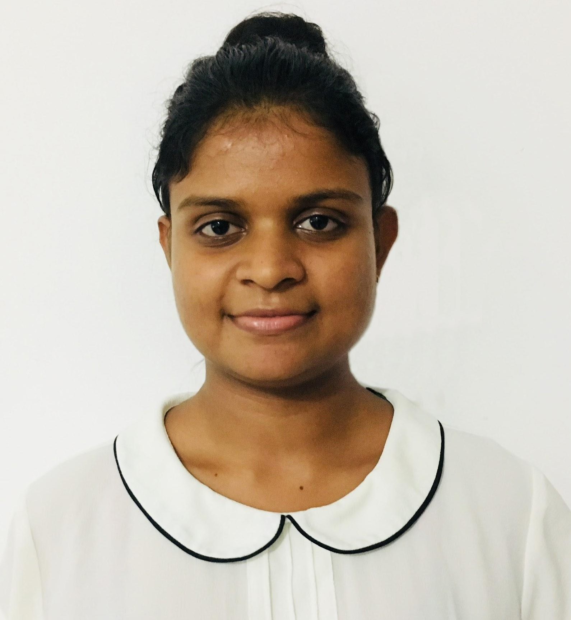
IT16138896 | Dissanayake D.M.K.P.
Road Accident Prediction
SLIIT
FACULTY OF COMPUTING IT16138896| Dissanayake D.M.K.P. | 2020-052
9/23/2020
8

Slide 9


^{Background}
1.35 million deaths approximately per each year globally according to the statistics on the World Health Organization (WHO) [4]
93% of fatalities from road accidents are reported from low- and middle-income countries [4]
Existing conventional solutions contain downsides
Police require a proper solution to reduce road accidents and their consequences
Main Reasons:
Traffic rule violations
Drunk driving
Overtake
Weather conditions
Speed
SLIIT
FACULTY OF COMPUTING IT16138896| Dissanayake D.M.K.P. | 2020-052
9/23/2020
9

Slide 10


^{Research Gap}
 | Paper [5] | Paper [6] | Paper [7] | paper [8] | Smart Cop
Predict vicinity of road accidents
Predict frequency of road accidents
Speculate severity of road accidents
Predict reasons for road accidents
Implement a user-friendly web based application
SLIIT
FACULTY OF COMPUTING IT16138896| Dissanayake D.M.K.P. | 2020-052
9/23/2020
10

Slide 11


Research Question
Research Objectives
How road accident prediction exactly reduce the impact of road accidents?
Implement a road accident prediction model based on historical data using Supervised & Unsupervised Learning algorithms
Predict the severity of road accidents
Speculate the reasons for road accidents
Predict the frequency of road accidents
Cluster the vicinities of road accidents
Deliver Results via user-friendly web-based application
SLIIT
FACULTY OF COMPUTING IT16138896| Dissanayake D.M.K.P. | 2020-052
9/23/2020
11

Slide 12
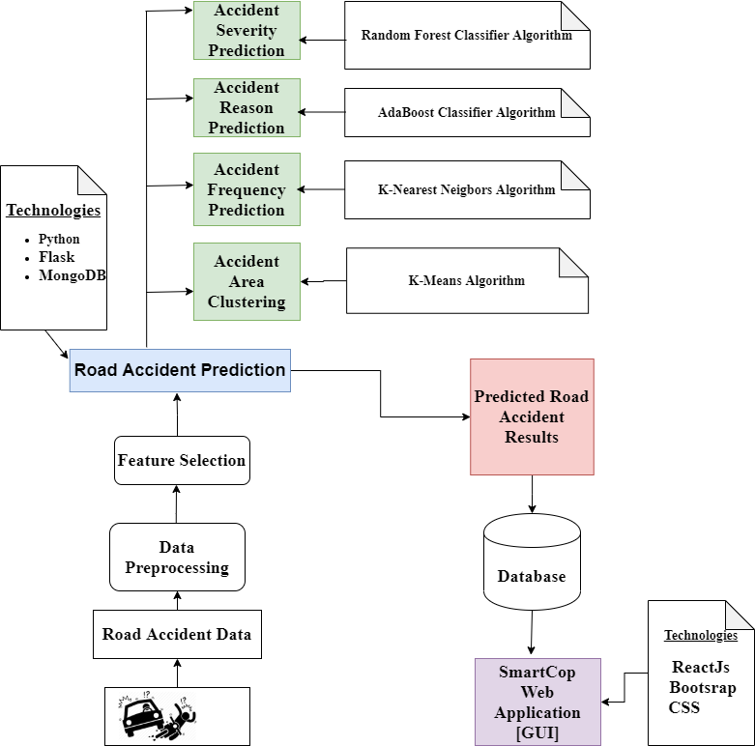
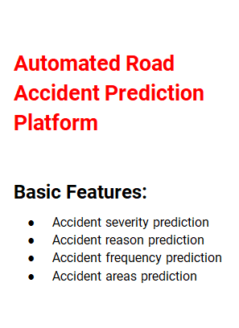
^{Methodology}
SLIIT
FACULTY OF COMPUTING IT16138896| Dissanayake D.M.K.P. | 2020-052
9/23/2020
12

Slide 13
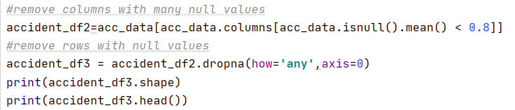
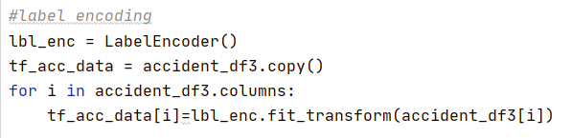
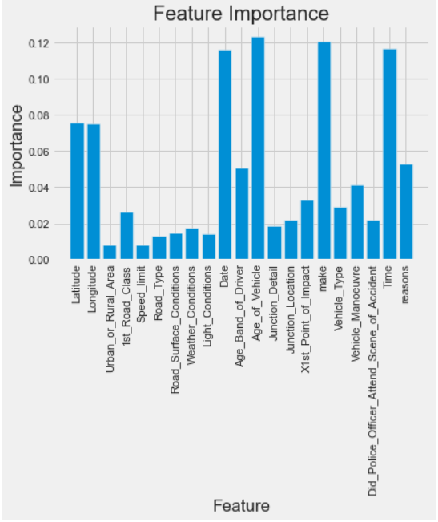
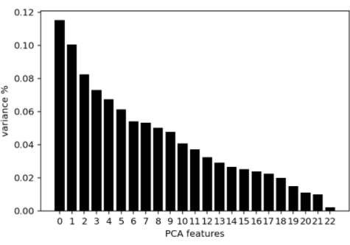
1. Dataset
Number of records: 1,038,182
Number of input features: 52
2. Preprocessing
Data cleaning
Remove rows with Null values
Remove columns with Null and 0 values
Normalization by label encoding
Output: 830,719 number of records
3. Feature Selection
Feature importance - severity, reason, frequency predictions
Referring related works - severity prediction
Principal Components Analysis (PCA) - Vicinity clustering
SLIIT
FACULTY OF COMPUTING IT16138896| Dissanayake D.M.K.P. | 2020-052
9/23/2020
13

Slide 14
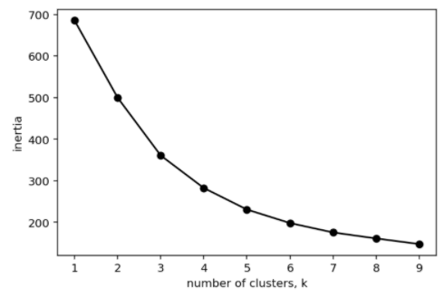
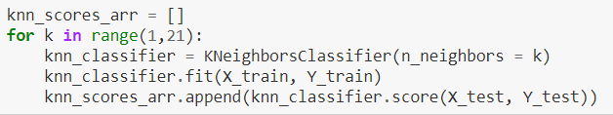
Road Accident Severity Prediction
Road Accident Reason Prediction
Algorithm : Random Forest Classifier (RFC)
Training Set : 80%
Testing Set : 20%
Compare accuracy with AdaBoost classifier and select the best one
Algorithm : AdaBoost Classifier
Training Set : 80%
Testing Set : 20%
Testing results are saved in MongoDB and as JSON
Road Accident Frequency Prediction
Road Accident Vicinity Clustering
Algorithm : K-Nearest Neighbours (KNN)
Training Set : 60%
Testing Set : 40%
Best K is selected as 3
Algorithm : K-means
Number of clusters (K) = 4
Elbow method is used for selecting K
SLIIT
FACULTY OF COMPUTING IT16138896| Dissanayake D.M.K.P. | 2020-052
9/23/2020
14

Slide 15
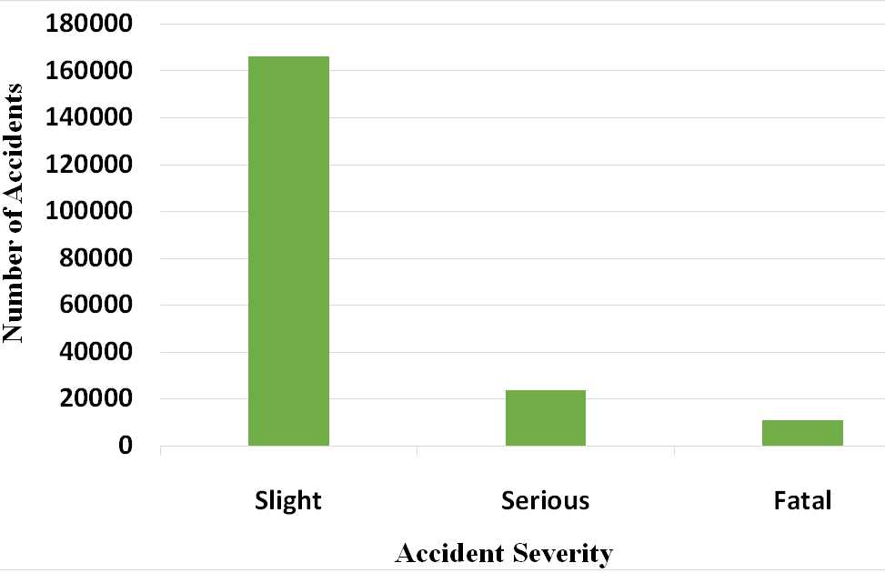
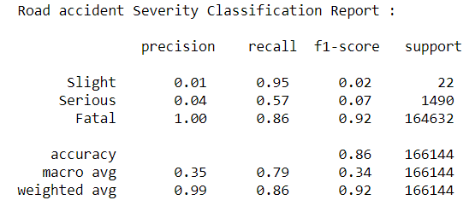
^{Achievements}
Accuracy with RFC is 85.76%
Accuracy with AdaBoost is 85.64%
The selected algorithm: RFC
Classification
Slight - 82.7%
Serious - 11.8%
Fatal - 5.4%
Road Accident Severity Prediction
SLIIT
FACULTY OF COMPUTING IT16138896| Dissanayake D.M.K.P. | 2020-052
9/23/2020
15

Slide 16
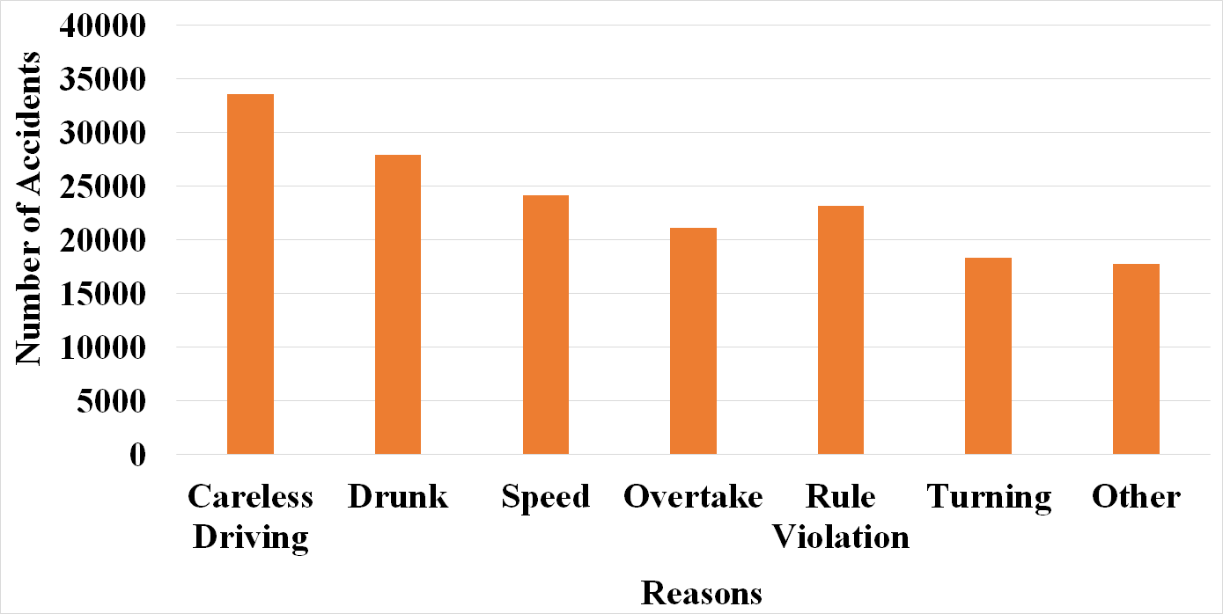
^{Achievements}
Accuracy with 21 input features is 24.12%
Accuracy with six input features is 48.12%
Classification:
Careless driving
Drunk driving
Speed
Overtake
Rule violation
Turning
Other reasons
Output classification:
Highest - Careless driving 20.20%
Least - Other reasons-10.69%
Road Accident Reason Prediction
SLIIT
FACULTY OF COMPUTING IT16138896| Dissanayake D.M.K.P. | 2020-052
9/23/2020
16

Slide 17
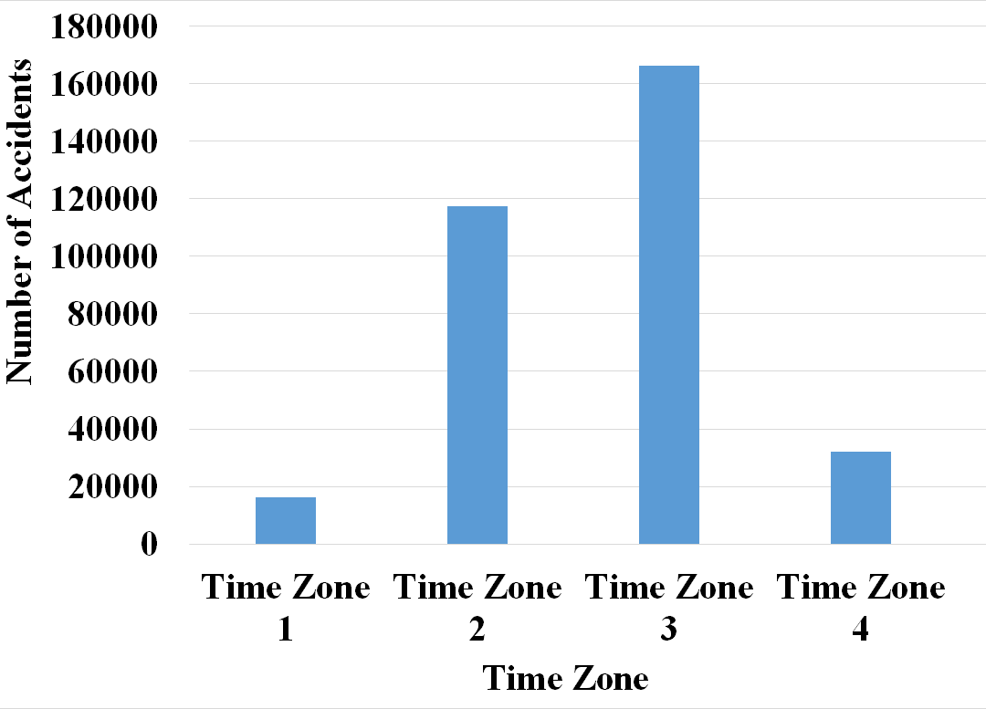
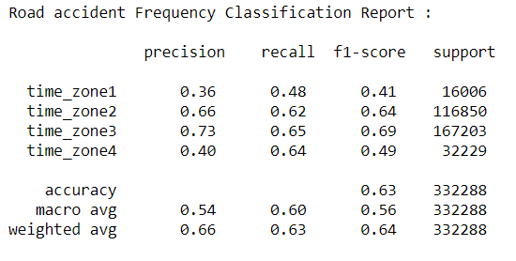
^{Achievements}
Accuracy with KNN is 63.15%
Classified time zones:
Time zone 1 (12.00 am to 6.00 am)
Time zone 2 (6.00 am to 12.00 pm)
Time zone 3 (12.00 pm to 6.00 pm)
Time zone 4 (6.00 pm to 12.00 pm)
Output classification:
Highest - Time Zone 3 - 50.07%
Least - Time Zone 1 - 4.90%
More accidents - Day time
Road Accident Frequency Prediction
SLIIT
FACULTY OF COMPUTING IT16138896| Dissanayake D.M.K.P. | 2020-052
9/23/2020
17

Slide 18
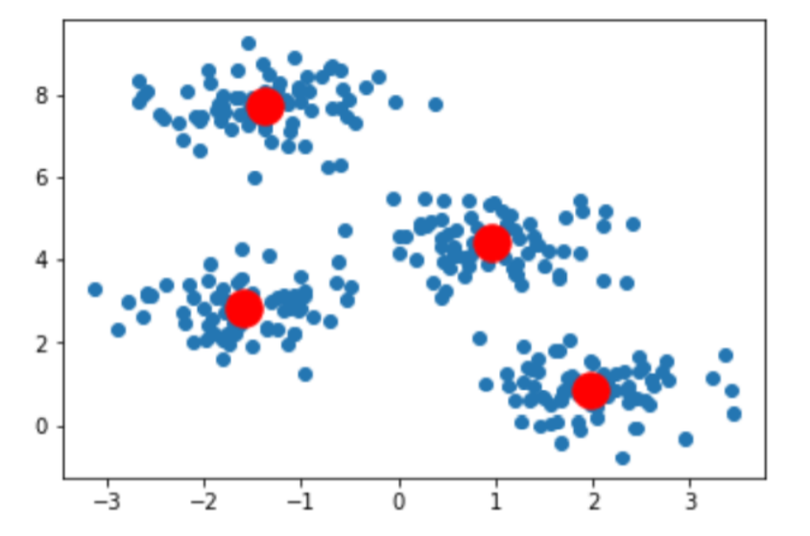
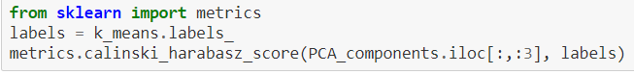
^{Achievements}
Number of accidents per clustered area:
Area 1: 278,746
Area 2: 216,447
Area 3: 207,392
Area 4: 128,134
Calinski Harabasz Score (CH score) - 45.61
Road Accident Vicinity Clustering
SLIIT
FACULTY OF COMPUTING IT16138896| Dissanayake D.M.K.P. | 2020-052
9/23/2020
18

Slide 19
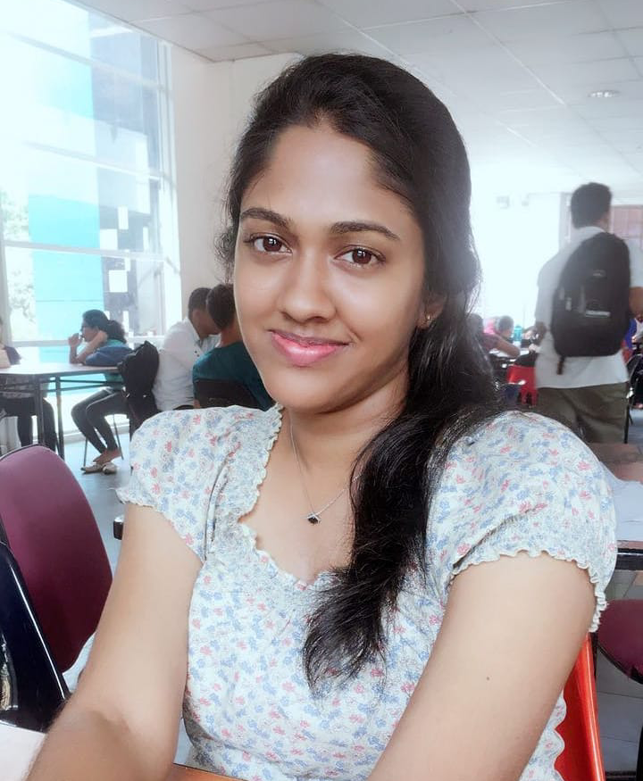
IT16165830 | Sewwandi A.K.T.
Officers Recommendation & Scheduling
SLIIT
FACULTY OF COMPUTING IT16165830 | Sewwandi A.K.T | 2020-052
9/23/2020
19

Slide 20

^{Background}
To reduce traffic traffic accidents proper scheduling and enforcement of traffic police officers is one of the best solution [9].
But, most existing scheduling systems has many drawbacks due to following a manual approach
Inaccuracy of handling large scale staff.
Lack performance of decision making
Difficult to replace new officer with the scheduling task.
Not proposing suitable officers for suitable task
Time consuming
There a proper traffic police officers scheduling system is a vast requirement.
SLIIT
FACULTY OF COMPUTING IT16165830 | Sewwandi A.K.T | 2020-052
20
9/23/2020

Slide 21
Research Question
Research Objectives
Implement a traffic police officers scheduling model using Machine learning and optimization
How to schedule traffic police officers accurately to reduce the impact of traffic accidents?
Filtering top most predicted reasons for occurring accidents
Recommend traffic police officers based on experience analysis
Schedule traffic police officers utilizing optimization
Send notifications for allocated officers
Deliver Results via user-friendly web-based application
SLIIT
FACULTY OF COMPUTING IT16165830 | Sewwandi A.K.T | 2020-052
9/23/2020
21

Slide 22
^{Research Gap}
 | Paper [10] | Paper [11] | Paper [12] | paper [13] | paper [14] | Smart Cop
Use optimization to schedule
Use recommendation & optimization to schedule
Conducted a experience analysis of officers
Followed a mathematical approach in optimization
Implemented a cost effective schedule
Send notifications to scheduled officers
SLIIT
FACULTY OF COMPUTING IT16165830 | Sewwandi A.K.T | 2020-052
9/23/2020
22

Slide 23
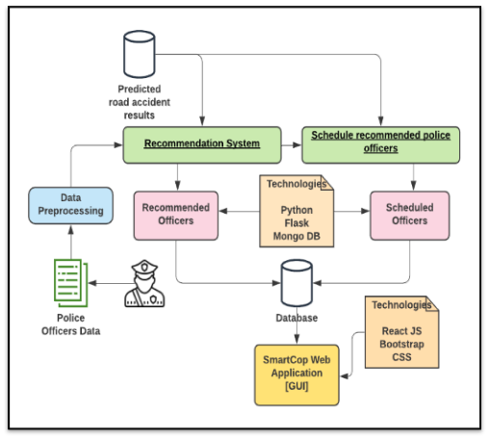
^{Methodology}
Automated platform for scheduling traffic police officers
Basic Features
Recommending traffic police officers based on experience analysis
Scheduling recommended officers using optimization
SLIIT
FACULTY OF COMPUTING IT16165830 | Sewwandi A.K.T | 2020-052
9/23/2020
23

Slide 24
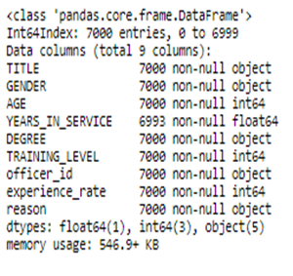
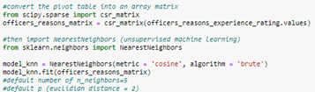
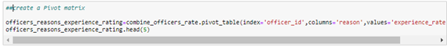
1. Dataset
Number of input features: 9
Number of records: 70,000
2. Preprocessing
Data Cleaning
Removed null values
Removed unnecessary fields
Merged two datasets with necessary fields
Creating the pivot table
Index: officer_id
column: reasons
value:experience rating
Creating the sparse matrix
For better performance
SLIIT
FACULTY OF COMPUTING IT16165830 | Sewwandi A.K.T | 2020-052
9/23/2020
24

Slide 25
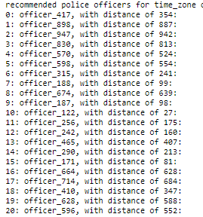
Recommendation System
Random officer selection
Filtering top most reasons for occurring accidents in each time zone.
use severity and reason prediction
select the random officer having higher experience for the filtered reasons
Algorithm
K Nearest Neighbors
Cosine similarity
to measure the distance between data points
Recommendation Approach
Collaborative filtering
Opposite approach of the typical collaborative filtering
Recommending officers for 4 time zones
Based on their experience analysis
Select similar officer for the filtered random officer
Number of recommending officers can be adjusted by n_neighbors (number of neighbors) parameter
SLIIT
FACULTY OF COMPUTING IT16165830 | Sewwandi A.K.T | 2020-052
9/23/2020
25

Slide 26
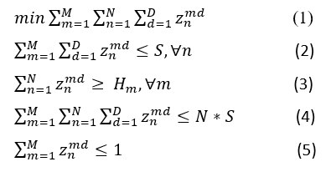
Scheduling Recommended Officers
Scheduling problem was considered as an optimization problem
Designed a mathematical model
Implemented using Gurobi
A commercial optimization solver
Objective Function : minimize the number of shifts allocating for each officer within the schedule duration
Constraint 1 : a police officer cannot allocated more than the maximum number of shifts a police officer can have
Constraint 2 : number of Police officers allocated for each checkpoint, satisfied the required number of police officers within each checkpoint
Constraint 3 : total number of scheduled officers should not exceed exceeds the total possibilities available for them.
Constraint 4: one officer can allocated to one checkpoint within a day
N | number of police officers
M | number of checkpoints
Z_{nmd} | Binary decision variable
S | maximum number of shifts per officer
Hm | Required number of officers for checkpoint m
D | Schedule duration (week)
SLIIT
FACULTY OF COMPUTING IT16165830 | Sewwandi A.K.T | 2020-052
9/23/2020
26

Slide 27
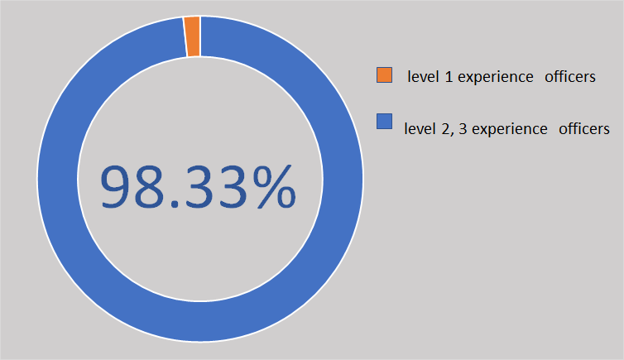
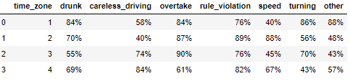
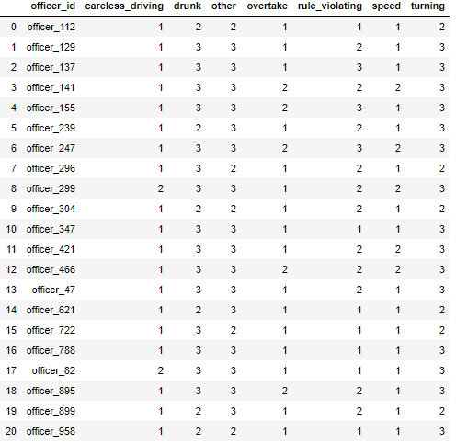
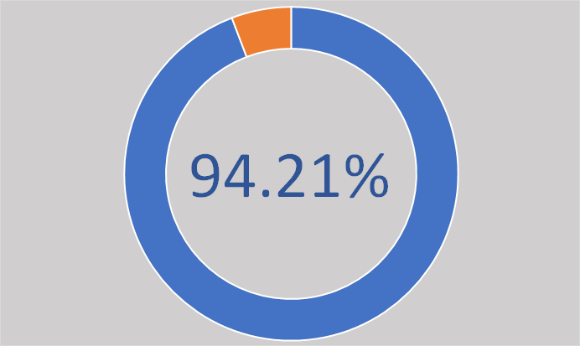
^{Achievements}
Experiment 01
(level 3 random officer)
Recommendation
Higher & medium level experiences officers
98.33%
Lower level experienced officers
1.67%
Experiment 02
(level 2 random officer)
Higher & medium level experiences officers
94.21%
Lower level experienced officers
5.79%
recommended officers for time zone 01
SLIIT
FACULTY OF COMPUTING IT16165830 | Sewwandi A.K.T | 2020-052
27

Slide 28
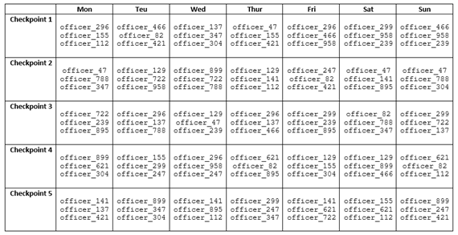
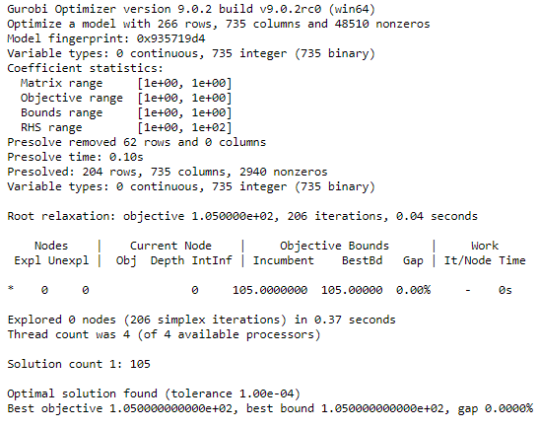
^{Achievements}
Scheduling
optimal solution
Recommended officers were scheduled to the checkpoints perfectly
No officers have scheduled more than the maximum shifts within the week
No officer have scheduled for same day twice
satisfy the required number of officers for each checkpoint
Cost effective optimal schedule that avoid an officer is scheduled for extra shifts which caused for OT work
SLIIT
FACULTY OF COMPUTING IT16165830 | Sewwandi A.K.T | 2020-052
28

Slide 29
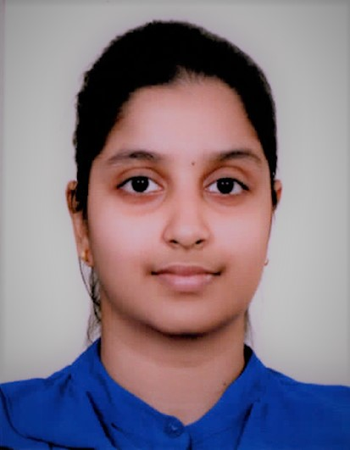
IT16170094 | Navanjani D.H.K.H.
Road Accident Prevention through Game-Based Learning
SLIIT
FACULTY OF COMPUTING
9/23/2020
29

Slide 30
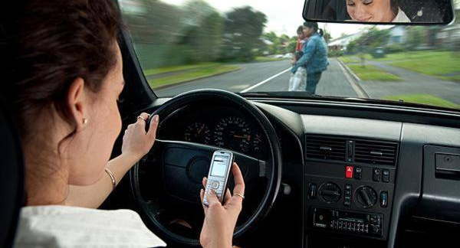
^{Background}
Insufficient exposure and consciousness among populations about traffic environments and rules cause the growth of road accident statistics [15].
Primary risk factors for road traffic injuries [16] are;
exceeding speed limits
driving under the impact of alcohol and other drugs
nonuse of motorcycle helmets,seat-belts, and child restraints
distracted driving
Concept is to examine whether the critical thinking skills gained through game based learning more beneficial to learn and retain road safety best practices.
SLIIT
FACULTY OF COMPUTING
9/23/2020
30

Slide 31
Research Gap
Features | Road Signs Game[17] | Pic Quiz Road Signs[18] | Pinoy Road Signs Quiz Game[19] | Memory Game Road Signs[20] | SmartCop Road Safety Awareness Game
Offering an overview explanation of traffic signs as feedback | ✔ | X | X | X | ✔
Enhancing memorization skills | ✔ | ✔ | ✔ | ✔ | ✔
Allowing to review previous attempts and analyze progress | ✔ | X | X | ✔ | ✔
Dynamic Difficulty Adjustment in Game Levels | X | X | X | X | ✔
SLIIT
FACULTY OF COMPUTING
9/23/2020
31

Slide 32
Research Question
Research Objectives
To implement a mobile game to enhance public awareness of road accident prevention during the CDAP evaluation cycle using Game-Based Learning and Machine Learning throughout the year.
Do critical thinking skills gained through game-based learning more beneficial to learn road safety best practices?
01
02
03
04
To develop a game which is equally impressive for both children and adults.
To address most of the causing factors for road accidents.
To design difficulty levels that are suited to individual skill levels.
To improve knowledge retention, decision making, problem-solving skills.
SLIIT
FACULTY OF COMPUTING
32
9/23/2020

Slide 33
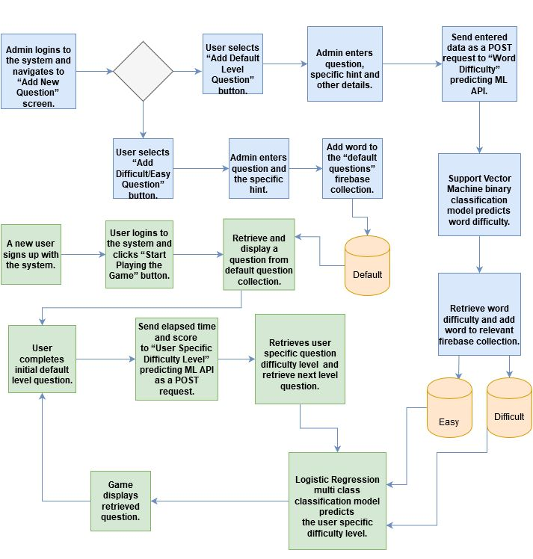
Methodology
Implement Support Vector Machine Binary Classification model to predict word difficulty and train that model using dataset obtained from Kaggle.
Develop the hangman mobile game using Flutter.
Implement Logistic Regression Multi Class Classification model to predict User Specific Question Difficulty and train that model using data obtained from users that have played the game.
Implement a flask server to use as a backend for API, deploy that API on Heroku and access that via mobile app.
SLIIT
FACULTY OF COMPUTING
9/23/2020
33

Slide 34
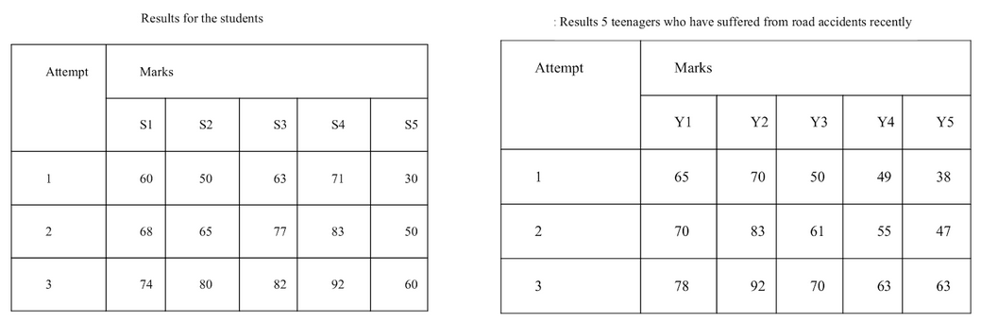
Achievements
Expected skills of the people are improved when no of attempts increased, and through that awareness among the public is improved.
Critical thinking skills gained through game-based learning are more beneficial to learn road safety best practices.
SLIIT
FACULTY OF COMPUTING
9/23/2020
34

Slide 35

DEMO
SLIIT
FACULTY OF COMPUTING IT16170094| Navanjani D.H.K.H. |2020-052
9/23/2020
35

Slide 36
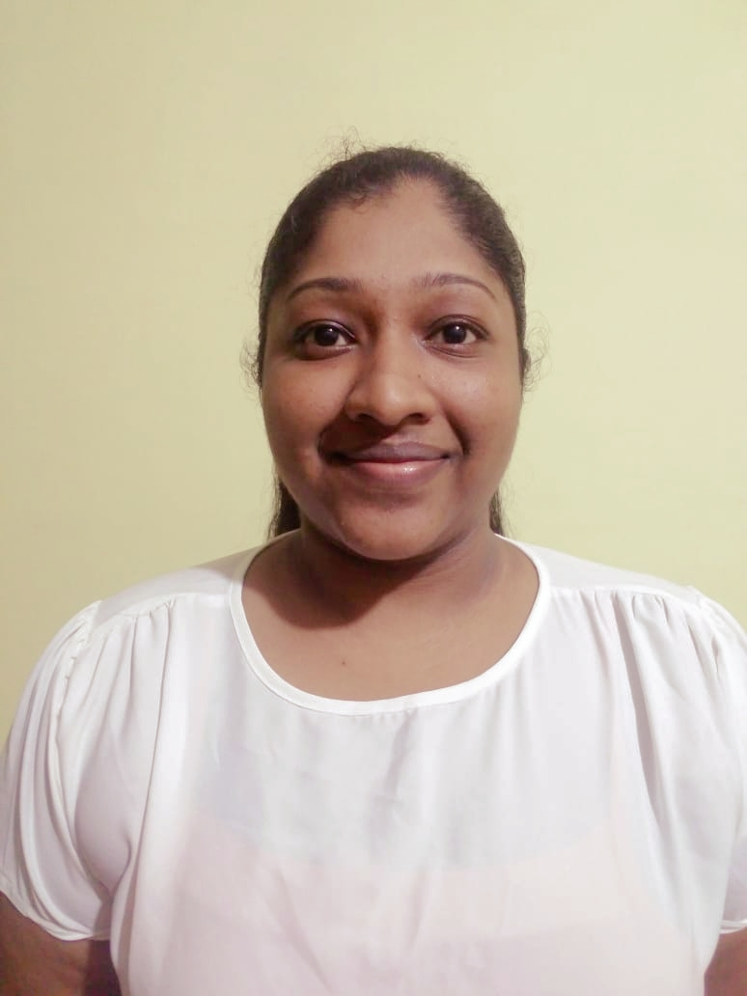
IT16167124 | Shangavie R
Post Road Accident Response Awareness Game
SLIIT
FACULTY OF COMPUTING IT16167124 | Shangavie R | 2020-052
9/23/2020
36

Slide 37
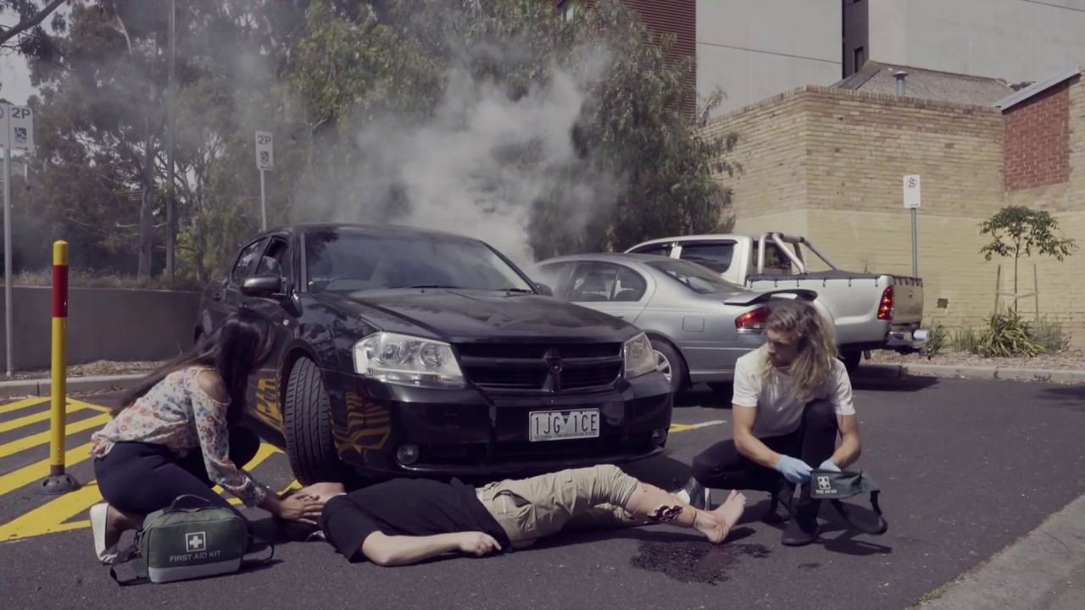

^{Background}
Game based learning improves knowledge more than the theoretical approaches[21]
So using the game based application, post road accident responsibility knowledge can be improved.
The existing games which are related to improving responsibility knowledge contain default game levels.
Issues faced due to default levels are:
People feels bore on game, slow improvement on knowledge
Difficult to measure player’s performance level
Therefore developing a mobile game with dynamic difficulty adjustment level feature improves interaction between players and the game.
SLIIT
FACULTY OF COMPUTING IT16167124 | Shangavie R | 2020-052
37
9/23/2020

Slide 38
Research Gap
Features | First Aid Quiz[22] | First Aid MCQ[23] | First Aid Ireland Pop Quiz[24] | First Aid Self Test[25] | SmartCop-Safe Life Quiz game
Measure the awareness level of player using their score
Measure the time that a player spent on each question to answer
Maintaining a leader board
Dynamic Difficulty Adjustment in game levels.
SLIIT
FACULTY OF COMPUTING IT16167124 | Shangavie R | 2020-052
38
9/23/2020

Slide 39
Research Question
Research Objectives
To develop a game-based mobile application with dynamic difficulty level adjustment using supervised learning algorithm to improve the post road accident responsibility knowledge.
How post road accident responsibility knowledge will be improved through game-based learning?
01
02
03
04
Predict questions based on the player’s performance using supervised learning algorithm
Predict time based on the player’s performance using supervised learning algorithm
Display obtained score based on the given input provided by the player
Display player’s position on the leaderboard
SLIIT
FACULTY OF COMPUTING IT16167124 | Shangavie R | 2020-052
39
9/23/2020

Slide 40
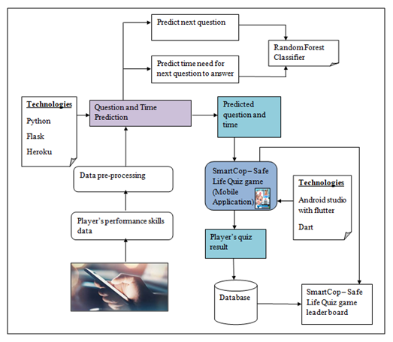
^{Methodology}
^{Implementation}
Develop the mobile application using Flutter.
Implement a machine learning model to predict both questions and time need for next question to answer using random forest classifier algorithm.
Create the flask server to use as a backend for API.
^{Deploy the API on Heroku}
Connect mobile application and machine learning model using an URL generated by Heroku
SAFE LIFE QUIZ
SLIIT
FACULTY OF COMPUTING IT16167124 | Shangavie R | 2020-052
40
9/23/2020

Slide 41



Achievements
SLIIT
FACULTY OF COMPUTING IT16167124 | Shangavie R | 2020-052
41
9/23/2020

Slide 42

Safe Life Quiz - Results
Attempt | Marks
 | S1 | S2 | S3 | S4 | S5 | T1 | T2 | T3 | T4 | T5 | N1 | N2 | N3 | N4 | N5
1 | 60 | 50 | 63 | 71 | 30 | 65 | 70 | 50 | 49 | 38 | 35 | 23 | 60 | 59 | 64
2 | 68 | 65 | 77 | 83 | 50 | 70 | 83 | 61 | 55 | 47 | 48 | 35 | 75 | 68 | 70
3 | 74 | 80 | 82 | 92 | 60 | 78 | 92 | 70 | 63 | 63 | 55 | 50 | 83 | 82 | 88
S - Students
T - Teenagers who have suffered from road
accidents recently
N - Non-medical professionals
SLIIT
FACULTY OF COMPUTING IT16167124 | Shangavie R | 2020-052
42
9/23/2020

Slide 43
REFERENCES
[1] Sunday Observer. 2020. Road Courtesy – Best Solution For Traffic Accidents. [online] Available at: <http://www.sundayobserver.lk/2018/07/22/thoughts/road-courtesy-%E2%80%93-best-solution-traffic-accidents> [Accessed 23 September 2020].
[2] “Road traffic injuries,” World Health Organization. [Online]. Available: https://www.who.int/news-room/fact-sheets/detail/road-traffic-injuries. [Accessed: 03-Feb-2020].
[3] Q. Li, R. Tay, R. Louis, "Designing Digital Games to Teach Road Safety: A Study of Graduate Students' Experiences", 2012.​
[4](2020,23-April-2020).Roadtrafficinjuries.Available:https://www.who.int/news-room/fact-sheets/detail/road-traffic-injuries#:~:text=Approximately%201.35%20million%20people%20die,of%20their%20gross%20domestic%20product.
[5] TD Liyanage, TM Rengarasu - 2012 - pdfs.semanticscholar.org (https://pdfs.semanticscholar.org/5485/0efc35028fb91630e5853a4d6e556faab9ab.pdf)
[6] G. Kaur and E. H. Kaur, "Prediction of the cause of accident and accident prone location on roads using data mining techniques," 2017 8th International Conference on Computing, Communication and Networking Technologies (ICCCNT), Delhi, 2017, pp. 1-7.
[7] Q. Liyan and S. Chunfu, "Macro Prediction Model of Road Traffic Accident Based on Neural Network and Genetic Algorithm," 2009 Second International Conference on Intelligent Computation Technology and Automation, Changsha, Hunan, 2009, pp. 354-357.
[8] M. F. Labib, A. S. Rifat, M. M. Hossain, A. K. Das and F. Nawrine, "Road Accident Analysis and Prediction of Accident Severity by Using Machine Learning in Bangladesh," 2019 7th International Conference on Smart Computing & Communications (ICSCC), Sarawak, Malaysia, Malaysia, 2019, pp. 1-5.
SLIIT
FACULTY OF COMPUTING
43

Slide 44
REFERENCES
[9] N. A. A. S. H. T. R. M. Sher, "The Traffic Police Location and Schedule Assignment Problem," (in English), 04 April 2014.
[10] G. Lukumay, D. Mkoka, A. Outwater, M. Ndile, and B.-I. Saveman, "Traffic Police Officers’ Experience of Post-crash Care to Road Traffic Injury Victims: A Qualitative Study in Dar es Salaam, Tanzania," ed: Research Square, 2019.
[11] D. Todovic, D. Makajic-Nikolic, M. Kostic-Stankovic, and M. Martic, "Police officer scheduling using goal programming," ISO 4 (alt) · Bluebook (alt1 · alt2) NLM (alt) · MathSciNet (alt ), vol. 38, no. 2, pp. 295-313, 2015.
[12] Taylor, P. E., & Huxley, S. J. (1989). A Break from Tradition for the San Francisco Police: Patrol Officer Scheduling Using an Optimization-Based Decision Support System. Interfaces, 19(1), 4–24. doi:10.1287/inte.19.1.4
[13] P. I. Thomas, "Scheduling Algorithm with Optimization of Employee Satisfaction," (in English), May 2013.
[14] Gröbner M., Wilke P. (2001) Optimizing Employee Schedules by a Hybrid Genetic Algorithm. In: Boers E.J.W. (eds) Applications of Evolutionary Computing. EvoWorkshops 2001. Lecture Notes in Computer Science, vol 2037. Springer, Berlin, Heidelberg. https://doi.org/10.1007/3-540-45365-2_48
SLIIT
FACULTY OF COMPUTING
44c

Slide 45
REFERENCES
[15] M. Hussin and N. Hanis Mohd Fouzi, "Computer Games as Learning Tool towards Children Road Safety Education", International Journal of Engineering & Technology, vol. 7, no. 415, p. 230, 2018.
[16] “Road traffic injuries,” World Health Organization. [Online]. Available: https://www.who.int/news-room/factsheets/detail/road-traffic-injuries. [Accessed: 03- Feb-2020].
[17] “Road Signs Game - Apps on Google Play,” Google. [Online]. Available: https://play.google.com/store/apps/details?id=com.wmm.androidgame&hl=en. [Accessed: 03-Feb-2020].
[18] “Pic Quiz: Road Signs - Apps on Google Play,” Google. [Online]. Available: https://play.google.com/store/apps/details?id=air.RoadSignQuiz&hl=en. [Accessed: 03-Feb-2020].
[19] “Pinoy Road Signs Quiz Game - Apps on Google Play,” Google. [Online]. Available: https://play.google.com/store/apps/details?id=com.allanjeffreynaval.pinoyroadsignquiz. [Accessed: 03-Feb-2020].
[20] “Memory Game - Road Signs - Apps on Google Play,” Google. [Online]. Available: https://play.google.com/store/apps/details?id=com.wMemorygameroadsigns_9976519. [Accessed: 03-Feb-2020].
SLIIT
FACULTY OF COMPUTING
45

Slide 46
REFERENCES
[21] A.Binsubaih, S.Maddock, and D.Romano, "A serious game for traffic accident investigators."
[22] a. T. Limited. "First Aid Quiz Game." https://play.google.com/store/apps/details?id=com.avistechbd.quiz (accessed 12-Jan-2020.
[23] E. Apps. "First Aid MCQ." https://play.google.com/store/apps/details?id=com.jdapp.firstaidmcq (accessed 12-Jan-2020.
[24] eoinzy. "First Aid Ireland Pop Quiz." https://play.google.com/store/apps/details?id=com.eoinzy.firstaid (accessed 12-Jan-2020.
[25] N. S. Games. "First Aid Self Test." https://play.google.com/store/apps/details?id=uk.co.nightsnow.first_aid_self_test (accessed 12-Jan-2020.
SLIIT
FACULTY OF COMPUTING
46

Slide 47

Any questions?
SLIIT
FACULTY OF COMPUTING
47

Slide 48

THANK YOU
THANK YOU
Place your screenshot here
SLIIT
FACULTY OF COMPUTING
48

